Slide 1
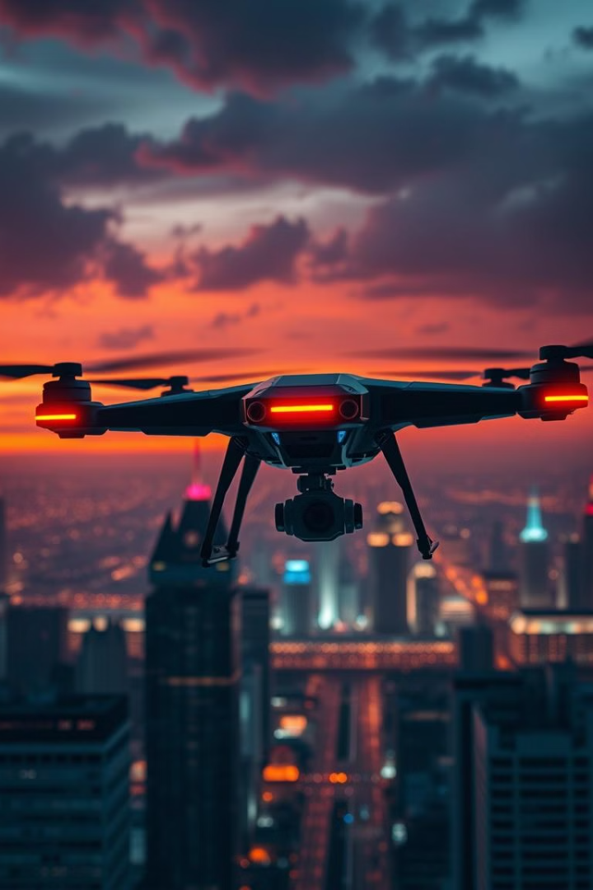
Security Surveillance Drone System
The Security Surveillance Drone System is an advanced autonomous aerial surveillance platform designed to enhance public safety and support law enforcement operations. This system utilizes cutting-edge drone technology, computer vision, and artificial intelligence to detect suspicious activities, monitor urban areas, and provide real-time alerts to authorities. This project implements a Pluto-based drone system specifically designed for crime detection and prevention.

Slide 2
Introduction to Security Surveillance Drones
Background
Problem Statement
Urban areas face increasing security challenges. Traditional surveillance methods often have limitations in coverage, flexibility, and response time. The Security Surveillance Drone System addresses these limitations by providing comprehensive aerial coverage, rapid deployment capabilities, and advanced detection algorithms.
Current security surveillance systems face several challenges including limited coverage areas, slow response times to incidents, high operational costs, and privacy concerns. The Security Surveillance Drone System aims to address these challenges through innovative technology and ethical implementation.

Slide 3
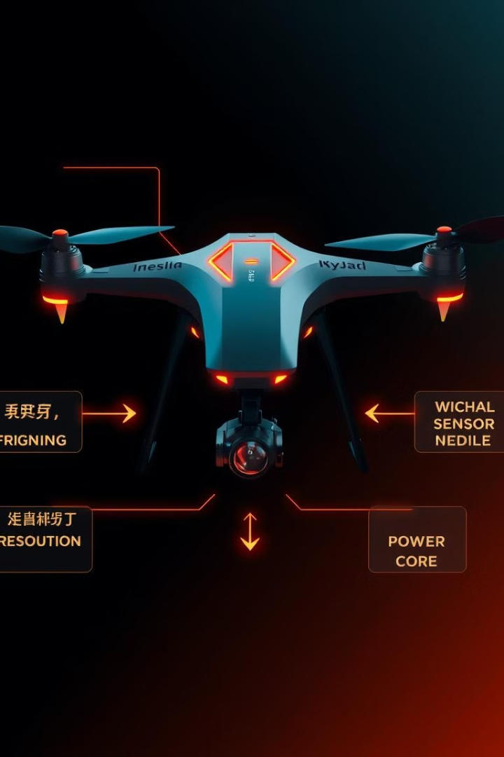
Technical Implementation
Drone Controller
Surveillance Module
Flight Management: Autonomous navigation, Obstacle avoidance
Video Processing: 4K camera, Thermal imaging
Detection System
Threat Recognition: AI algorithms, Pattern recognition

Slide 4
Pluto Framework Implementation
The Pluto framework provides the foundation for our drone control system. The following code demonstrates the basic implementation of our drone control system:
1 import numpy as np 2 from pluto import Drone , Environment 3 4 class SecurityDroneSimulation : 5 def __init__ ( self ) : 6 # Initialize drone with security - specific parameters 7 self . drone = Drone ( 8 mass =2.0 , # kg 9 max_thrust =25.0 , # N 10 max_velocity =20.0 , # m/s 11 battery_capacity =8000 # mAh 12 ) 13 14 # Create simulation environment 15 self . env = Environment ( 16 gravity =9.81 , 17 air_density =1.225 , 18 wind_speed =0.0 19 ) 20 21 # Initialize position and velocity 22 self . position = np . array ([0.0 , 0.0 , 0.0]) 23 self . velocity = np . array ([0.0 , 0.0 , 0.0]) 24 25 # Security - specific parameters 26 self . patrol_points = [] 27 self . suspicious_activities = [] 28 self . alert_threshold = 0.8 29 self . night_mode = False 30 self . thermal_mode = False

Slide 5
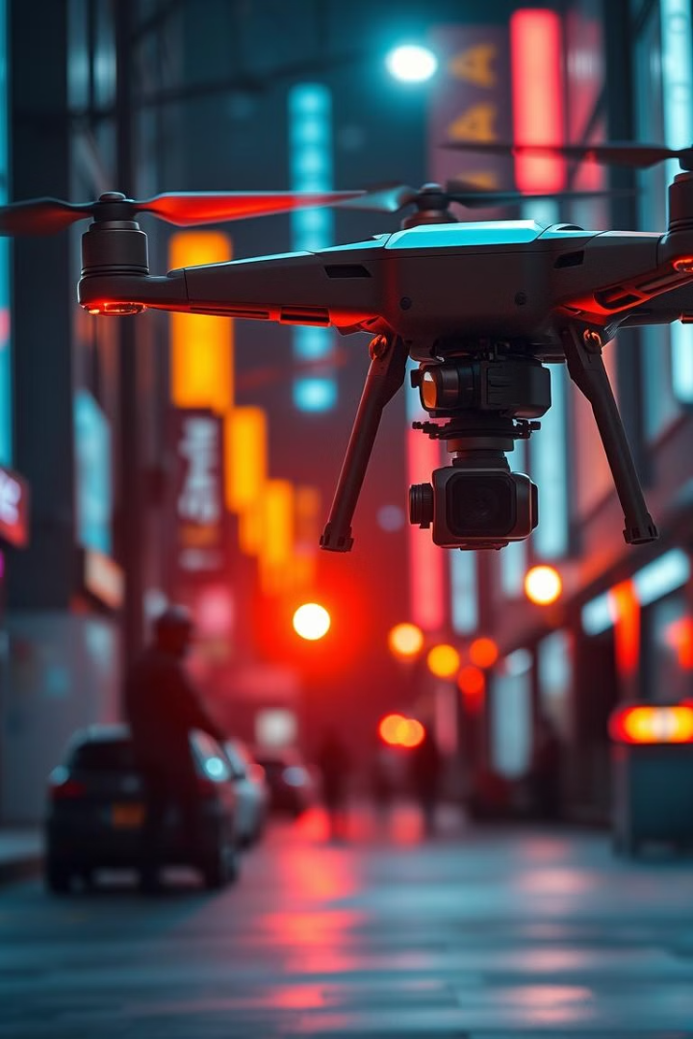

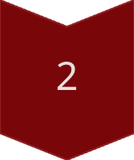
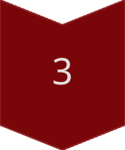
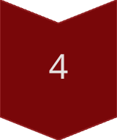
Crime Detection System
Detect Persons
Classify Actions
Detect Anomalies
Track Objects

Slide 6
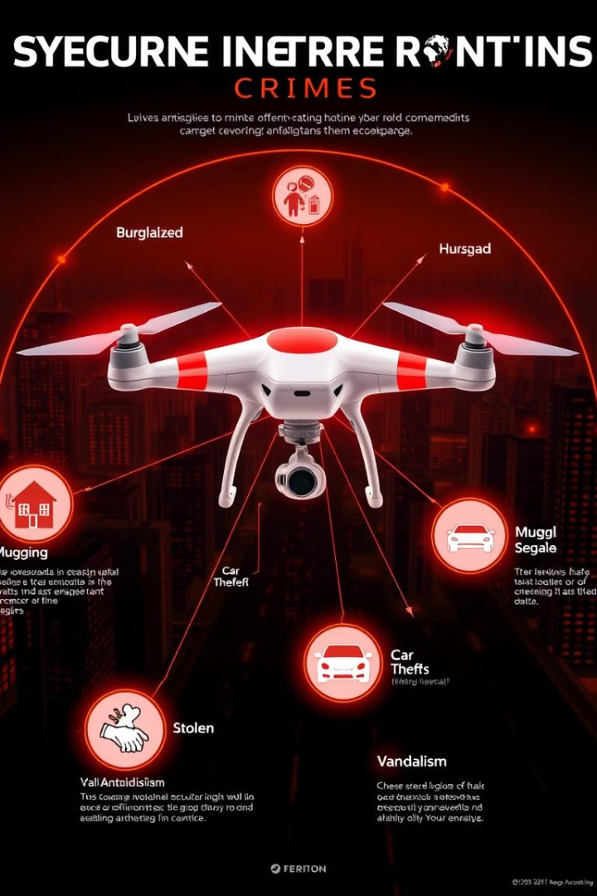
Crime Detection Categories
Category
Detection Type
Accuracy
Property Crimes
Vandalism
96%
Violent Crimes
Assault
93%
Vehicle Crimes
Speeding
98%

Slide 7
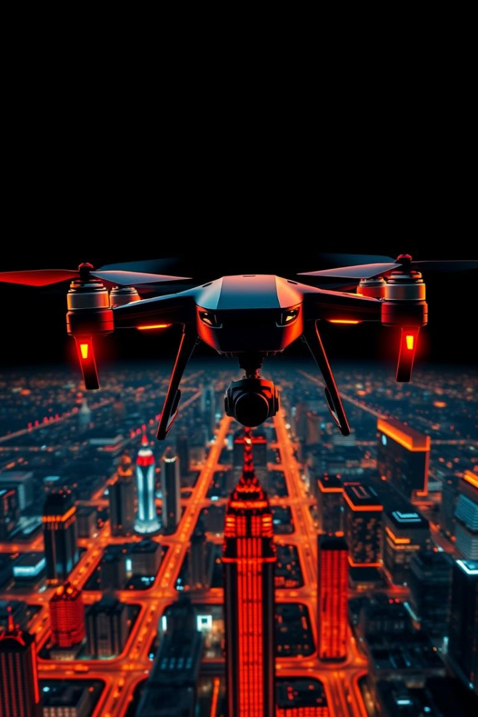
System Integration: Patrol Routes
The following code demonstrates the implementation of the patrol route functionality:
1 def setup_patrol_route ( self , points ) : 2 """ Define patrol route with waypoints """ 3 self . patrol_points = points 4 self . logger . info ( f" Patrol route established with { len( points )} waypoints ") 5 6 def patrol ( self , duration =60.0) : 7 """ Execute patrol route """ 8 if not self . patrol_points : 9 self . logger . warning ("No patrol route defined !") 10 return 11 12 time_elapsed = 0 13 current_point = 0

Slide 8


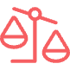

SDG Alignment
SDG 11
SDG 16
SDG 9
Enhanced urban security
Improved law enforcement
Technological innovation
Our Security Surveillance Drone System directly contributes to SDG 11 by enhancing urban security and creating safer communities. The system supports SDG 16 by improving law enforcement capabilities and strengthening institutions responsible for public safety. Our project advances SDG 9 by developing cutting-edge surveillance technology and implementing innovative approaches to public safety.

Slide 9




Privacy and Ethical Framework
Data Encryption
Access Control
AES-256
Role-based access
Data Retention
30-day limit

Slide 10
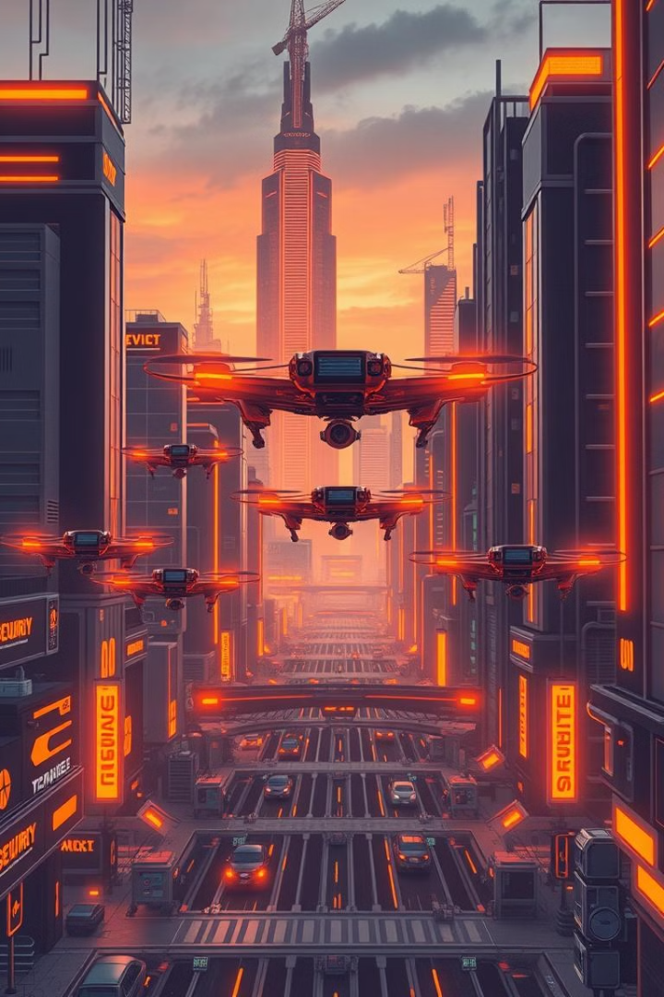
Conclusion
The Security Surveillance Drone System represents a significant advancement in public safety technology, combining autonomous aerial systems with advanced detection algorithms while maintaining strict privacy standards. The implementation of this system using the Pluto framework demonstrates the potential of autonomous drone technology to enhance public safety and support law enforcement operations.

